Slide 1
ADVANCED TRAFFIC MODELING AND CONGESTION MANAGEMENT SOLUTION FOR MODERN NETWORKING PLATFORMS
CSA-0732 COMPUTER NETWORKS FOR DATA CENTERS
Presented by:
Devadharshini E – 192524483
Janani .B -192521052
Tamizharasi .k -192512193
Guide by:
Dr. K. Senthil
Dr. P. Rajaram

Slide 2


LIST OF TABLES
Abstract
Introduction
Objectives
problem statement
Literature Review / Background
System Design / Architecture
Implementation
Methodology
Results & Discussion
Challenges & Limitations
Future Scope
Conclusion
References

Slide 3
ABSTACT
This project analyzes and manages network congestion using simulation tools like Cisco Packet Tracer.
In modern networking environments, the rapid growth of data-intensive applications and real-time services has intensified the need for advanced traffic modeling and effective congestion management strategies.
Traditional congestion control mechanisms often struggle to handle the dynamic and heterogeneous nature of today’s networks, leading to latency, packet loss, and reduced Quality of Service (QoS).

Slide 4
INTRODUCTION
This project focuses on developing advanced traffic modeling and congestion management techniques to improve data flow and network efficiency.
It aims to reduce packet loss, delay, and congestion by optimizing bandwidth and ensuring smooth communication across modern networking platforms.
It uses simulation tools like Cisco Packet Tracer to analyze network behavior under varying traffic loads.

Slide 5
OBJECTIVES
Define clear goals: To optimize network performance by accurately modeling traffic patterns and predicting congestion points.
Expected outcomes: Improved data flow efficiency, enhanced QoS (Quality of Service), and scalable network performance for modern platforms.

Slide 6
PROMBLEM STATEMENT
To minimize latency, packet loss, and bottlenecks through intelligent congestion management strategies.
As networks grow with more users and data, congestion happens — causing delay, packet loss, and poor performance.
Old methods can’t handle today’s dynamic traffic.
So, our project creates an intelligent and adaptive congestion management system that predicts and controls traffic to keep the network smooth and efficient.

Slide 7
Literature review
Author (Year) | Focus | Method | Key Findings | Relevance
Mystakidis et al. (2025) | Traffic congestion prediction | ML & hybrid models | Improved accuracy in real-time prediction | Useful for congestion forecasting module
Khan & Ivan (2023) | Smart-city traffic control | AI & IoT integration | Automated congestion detection & control | Supports AI use in network management
Usama et al. (2024) | Data traffic in AI-IoT | Edge analytics | Reduced packet loss, better throughput | Useful for IoT congestion solutions
Taher et al. (2025) | Congestion estimation & control | Computational intelligence | Optimized routing & queuing | Helps design adaptive congestion control

Slide 8
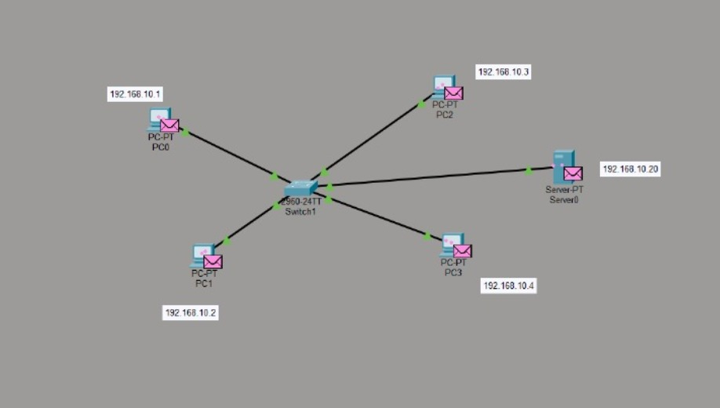
SYSTEM DESIGN/ARCHITECTURE

Slide 9
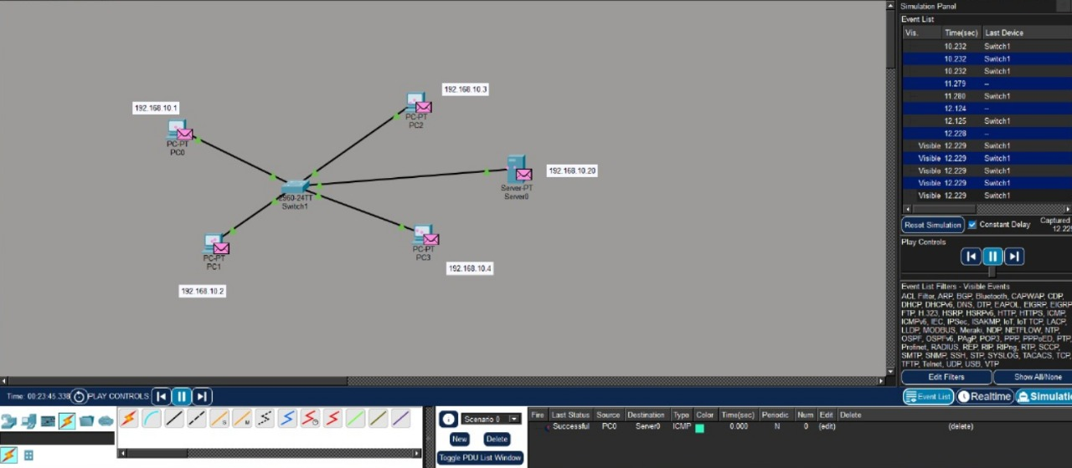
IMPLEMENTATION

Slide 10
METHODOLOGY
Tools & Frameworks Used: Cisco Packet Tracer and Wireshark are utilized to simulate, analyze, and visualize real-time network traffic and congestion scenarios.
• Development Approach: A modular and simulation-based approach is followed to design, test, and optimize traffic flow across multiple network topologies.
• Data Collection: Network performance metrics such as latency, packet loss, and throughput are gathered during simulations for congestion analysis and model evaluation.

Slide 11
Module 1: Network Traffic Analysis
Focuses on studying data flow patterns and identifying bottlenecks within a network.
Uses tools and models to measure bandwidth usage, packet loss, and latency.
Helps understand traffic behavior for optimizing network performance and predicting congestion.

Slide 12
Module 2: Congestion Management Strategies
Involves implementing algorithms and protocols to control and reduce network congestion.
Techniques include traffic shaping, load balancing, and priority-based queuing.
Ensures smooth data transmission and improved Quality of Service (QoS).

Slide 13
Module 3: Network Congestion Management Testing
Tests network performance under varying traffic loads to assess congestion control methods.
Uses simulation and real-time testing tools to evaluate system efficiency.
Validates the effectiveness of congestion management solutions in real-world conditions.

Slide 14

RESULT & DISSCUSSION
Outcomes of the Project: The proposed system effectively improves network performance by reducing congestion and optimizing bandwidth utilization.
Comparison with Existing Solutions: Compared to traditional static models, the advanced system offers faster data flow analysis and more accurate congestion prediction.

Slide 15
CHALLENGES & LIMITATIONS
Issues faced during development: Complex real-time data analysis and scalability issues make accurate traffic prediction difficult.
Possible constraints: High computational cost and limited interoperability with legacy network systems.

Slide 16
FUTURE SCOPE
Enhancements or Improvements: Incorporate AI-driven predictive analytics to optimize real-time traffic control and reduce congestion automatically.
Integrate with Software-Defined Networking (SDN) for dynamic bandwidth allocation and policy-based traffic management.
Expand to support IoT and 5G networks for high-speed, low-latency communication environments

Slide 17
CONCLUSION
This project provides advanced insights into traffic modeling, congestion management, and modern networking optimization, ensuring efficient data flow and reduced latency.
Key takeaways: Accurate traffic analysis, proactive congestion control, and intelligent QoS mechanisms enhance overall network performance and reliability.

Slide 18
REFERENCES
1. Mystakidis, A., Koukaras, P. and Tjortjis, C., 2025. Advances in traffic congestion prediction: an overview of emerging techniques and methods. Smart Cities, 8(1), p.25.
2. Khan, A.F. and Ivan, P., 2023. Integrating machine learning and deep learning in smart cities for enhanced traffic congestion management: An empirical review. J. Urban Dev. Manag, 2(4), pp.211-221.
3. Usama, M., Ullah, U., Muhammad, Z., Bux, M., Ullah, I., Rouf, M. and Islam, T., 2024. Data traffic management in AI-IoT network to reduce congestion. In artificial intelligence for intelligent systems (pp. 145-189). CRC Press.
4. Taher, Y.H., Mandeep, J.S., Marhoon, H.A., Al-Jamimi, H.A., Luqman, H., Azzedin, F., Abdullah, M., Al-Ahmadi, H.M. and Yaseen, Z.M., 2025. Traffic Congestion Estimation and ControlArchives of Computational Methods in Engineering, pp.1-62.
5. Ravish, R. and Swamy, S.R., 2021. Intelligent traffic management: A review of challenges, solutions, and future perspectives. Transport and Telecommunication, 22(2), pp.163-182.

Slide 19
REFERENCES(CONT..,)
6. Yue, W., Li, C., Mao, G., Cheng, N. and Zhou, D., 2021. Evolution of road traffic congestion control: A survey from perspective of sensing, communication, and computation. China Communications, 18(12), pp.151-177.
7. Almukhalfi, H., Noor, A. and Noor, T.H., 2024. Traffic management approaches using machine learning and deep learning techniques: A survey. Engineering Applications of Artificial Intelligence, 133, p.108147.
8. Taher, Y.H., Mandeep, J.S., Marhoon, H.A., Al-Jamimi, H.A., Luqman, H., Azzedin, F., Abdullah, M., Al-Ahmadi, H.M. and Yaseen, Z.M., 2025. Traffic Congestion Estimation and Control: A Comprehensive Review of the Applied Computational Intelligence Models. Archives of Computational Methods in Engineering, pp.1-62.
9. Matrood, M.Q. and Ali, M.H., 2025. Enhancing Network Congestion Control: A Comparative Study of Traditional and AI-Enhanced Active Queue Management Techniques. Journal of Cybersecurity & Information Management, 15(1).
10. Fadila, J.N., Wahab, N.H.A., Alshammari, A., Aqarni, A., Al-Dhaqm, A. and Aziz, N., 2024. Comprehensive Review of Smart Urban Traffic Management in the Context of the Fourth Industrial Revolution. IEEE Access.

